Slide 1
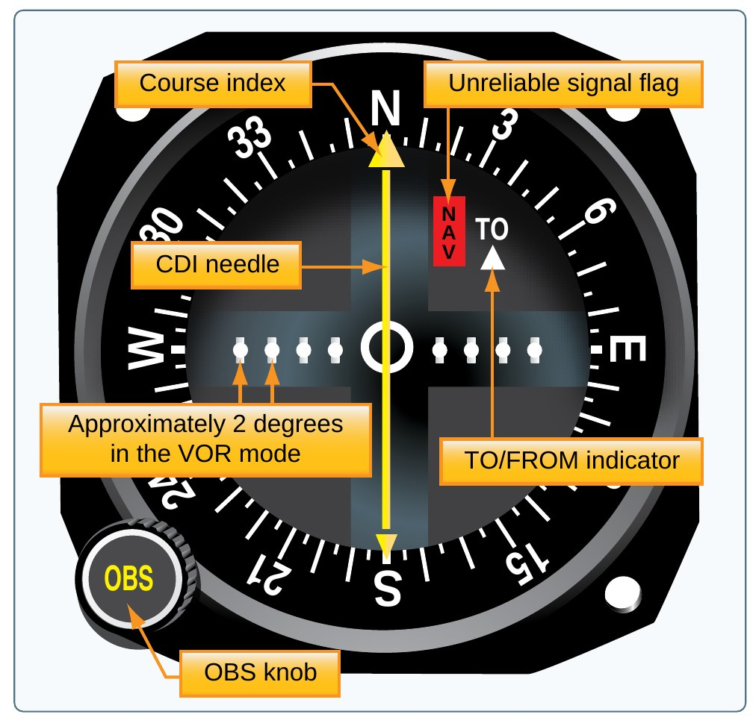
Missed ACS Codes Review
Nine knowledge codes, one lesson
Cessna 172S NAV III (G1000)
FAA-S-ACS-25
[Name], CFI Applicant
Source: PHAK Fig 16-29
1
Notes:
This lesson covers the nine codes I missed. For each one: the FAA definition, plain words, and how it applies to the C172S.

Slide 2
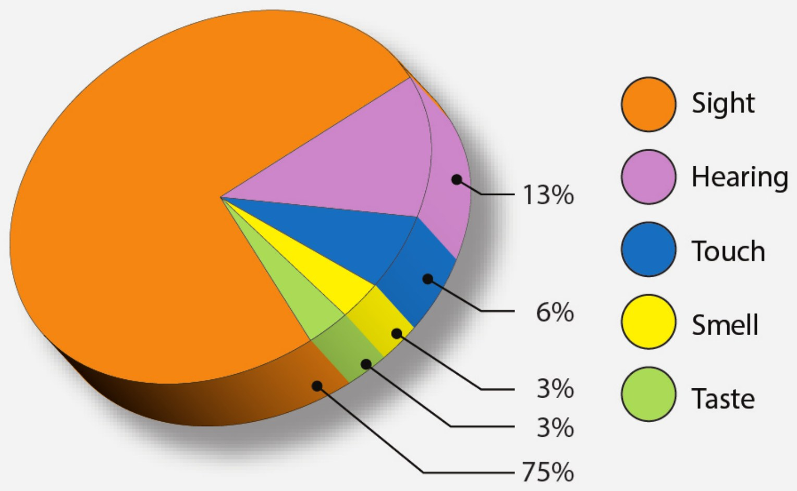
Objective
Review
Explain each missed code
Use FAA wording
Tie it to the C172S
Teach it back clearly
State the objective: explain each of the nine knowledge elements using FAA wording, apply it to the C172S, and teach it back.
Source: ACS FI.I.B, ACS AI.II, ACS AI.III.B, ACS AI.XII.D
2
Notes:
By the end I can explain every one of these codes the way I would teach it to a student, using the FAA books and the C172S POH.

Slide 3
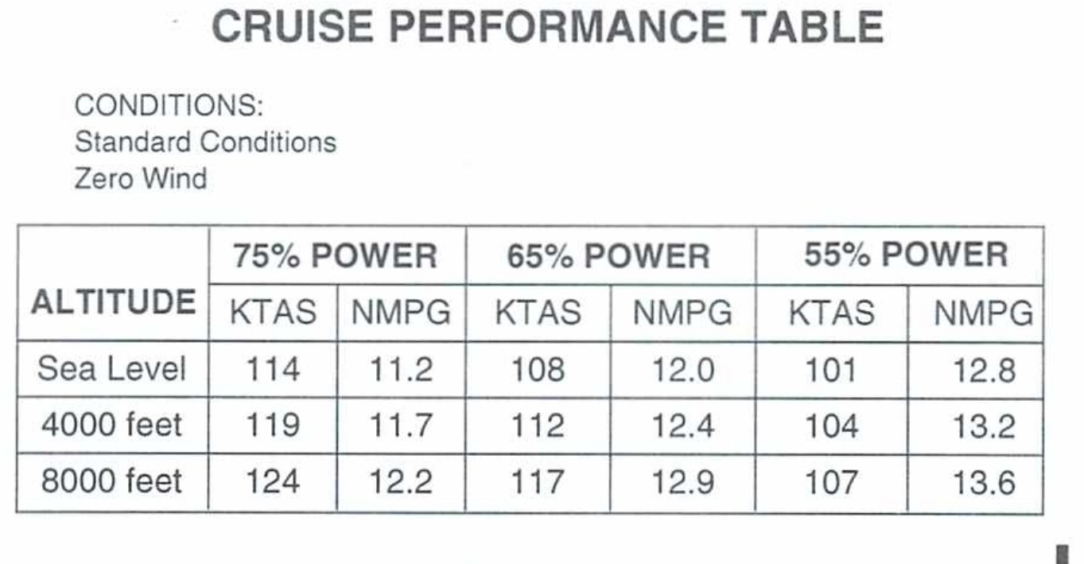
The Nine Codes
Review
Code | Topic
FI.I.B.K3 | Perceptions and insight
AI.II.D.K2 | Stability and control
AI.II.E.K1c | Powerplant and propeller
AI.II.F.K3 | Weight and balance terms
AI.II.H.K1 | Ground-based navigation
AI.II.I.K3 | Plotting a course
AI.II.I.K4 | Power setting selection
AI.III.B.K1b | Inspections and logbooks
AI.XII.D.K1 | ELT
Walk through the list. Each code gets two to five slides: the FAA definition, plain words, and a C172S example.
Source: FAA-S-ACS-25
3
Notes:
Here is the list in the order we will cover it.

Slide 4
FI.I.B.K3
Perceptions and Insight
What you will learn
What perceptions are
Five factors that affect perception
What insight is
How you build insight
Why it matters: every lesson you teach goes in through your student's senses. Knowing what blocks perception makes you a better instructor.
Source: AIH 3-7 to 3-9
4
Notes:
Section: Perceptions and Insight. Why it matters: every lesson you teach goes in through your student's senses. Knowing what blocks perception makes you a better instructor.

Slide 5
Definition: Perceptions
FI.I.B.K3
PERCEPTIONS
“Initially, all learning comes from perceptions, which are directed to the brain by one or more of the five senses: sight, hearing, touch, smell, and taste.”
MORE THAN ONE SENSE
“learning occurs most rapidly when information is received through more than one sense.”
IN PLAIN WORDS
Everything a student learns comes in through the senses. Show it, say it, and let them touch it, and it sticks faster.
KNOW THIS FOR THE CHECKRIDE
Sight is about 75 percent of learning. Sight and hearing together are about 88 percent (AIH Fig 3-5).
Source: AIH 3-7, AIH Fig 3-5
5
Notes:
Read the AIH words. The chart shows most learning comes through sight, and sight plus hearing is about 88 percent.

Slide 6
Factors That Affect Perception
FI.I.B.K3
Factor | Plain words
Physical organism | Senses must work
Goals and values | What they care about
Self-concept | Confident or not
Time and opportunity | Time and right order
Element of threat | Fear narrows focus
AIH 3-7 lists five factors: physical organism, goals and values, self-concept, time and opportunity, and element of threat. The study guide memory aid GSTEP covers the same five in a different order (GSTEP is not an AIH term).
Physical organism: the senses a pilot needs to see, hear, feel, and respond (AIH 3-8).
Goals and values: perceptions depend on what the learner values (AIH 3-8).
Self-concept: a positive self-image keeps the learner open to new experiences. A negative one creates barriers (AIH 3-8).
Time and opportunity: it takes time and the right order of experiences to perceive (AIH 3-8).
Element of threat: fear narrows the perceptual field, so threats do not help learning (AIH 3-8).
MEMORY AID
GSTEP (from your study guide): Goals and values, Self-concept, Time and opportunity, Element of threat, Physical organism.
EXAMPLE
AIH example: during the first steep turns, a learner may stare at the altimeter and ignore outside references. That is the element of threat narrowing perception (AIH 3-8).
Source: AIH 3-7, AIH 3-8
6
Notes:
Five factors. Your study guide uses GSTEP: Goals and values, Self-concept, Time and opportunity, Element of threat, Physical organism. That memory aid is from the study guide, not the AIH.

Slide 7
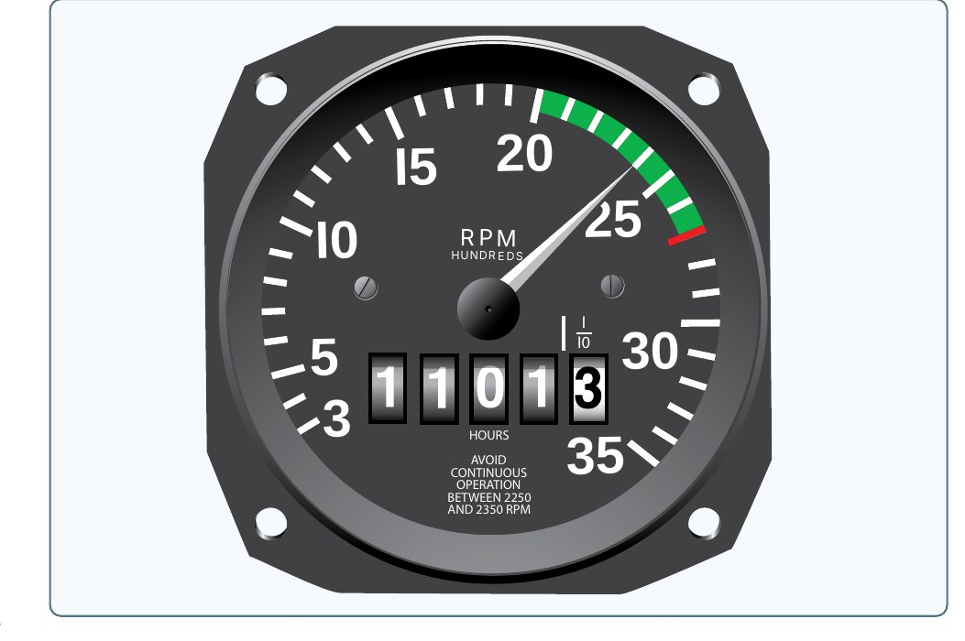
Definition: Insight
FI.I.B.K3
INSIGHT
“Insight involves the grouping of perceptions into meaningful wholes. Creating insight is one of the instructor's major responsibilities.”
IN PLAIN WORDS
Insight is the moment the pieces click. The student stops seeing throttle, RPM, and pitch as separate facts and sees how they work together.
EXAMPLE
AIH example made for the C172S: with a fixed-pitch propeller, rpm goes up when the throttle is opened and down when it is closed. Rpm also changes when pitch attitude changes with no power change. Engine speed, power, airspeed, and attitude are all related (AIH 3-9).
Source: AIH 3-9, PHAK Fig 7-8
7
Notes:
Insight is when the separate pieces click together into one picture.

Slide 8
How Instructors Build Insight
FI.I.B.K3
Point out relationships
Keep the learner receptive
Nonthreatening environment
Protect a good self-concept
Key steps from AIH 3-9: point out relationships as they occur, provide a secure and nonthreatening environment, and help the learner keep a favorable self-concept.
Insight almost always happens eventually, but instruction speeds it up by teaching how perceptions relate as they occur (AIH 3-9).
Source: AIH 3-9
8
Notes:
Insight happens on its own eventually, but good instruction speeds it up by pointing out how things connect as they happen.

Slide 9
Quick Check
FI.I.B.K3
1
Which sense accounts for most learning?
Answer: Sight, about 75 percent (AIH Fig 3-5).
2
Your student stares at the altimeter during their first steep turns. Which factor is at work?
Answer: Element of threat. Fear narrows perception (AIH 3-8).
3
What is insight?
Answer: Grouping perceptions into meaningful wholes (AIH 3-9).
Source: AIH 3-7 to 3-9, AIH Fig 3-5
9
Notes:
Ask each question and let the student answer before showing the answer. Q1: Which sense accounts for most learning? A: Sight, about 75 percent (AIH Fig 3-5). Q2: Your student stares at the altimeter during their first steep turns. Which factor is at work? A: Element of threat. Fear narrows perception (AIH 3-8). Q3: What is insight? A: Grouping perceptions into meaningful wholes (AIH 3-9).

Slide 10
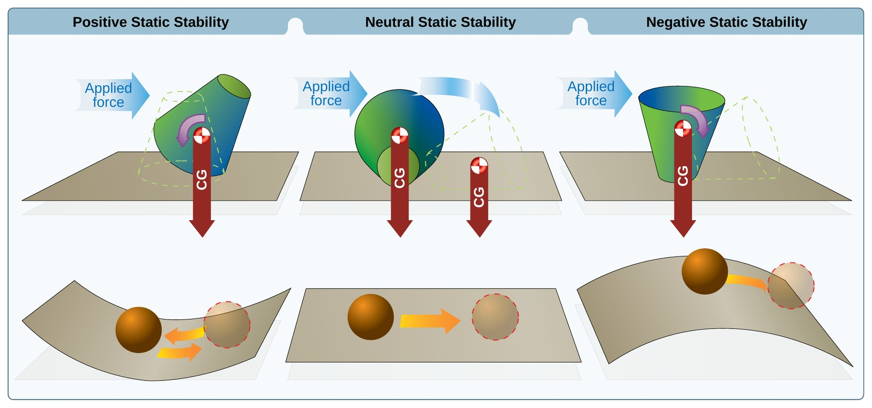
AI.II.D.K2
Stability, Maneuverability, and Controllability
What you will learn
Static vs. dynamic stability
Positive, neutral, negative
Maneuverability and controllability
How CG changes all three
Why it matters: this is why the C172S settles back down after a bump, and why loading it wrong makes it harder to fly.
Source: PHAK 5-14, PHAK 5-15
10
Notes:
Section: Stability, Maneuverability, and Controllability. Why it matters: this is why the C172S settles back down after a bump, and why loading it wrong makes it harder to fly.

Slide 11
Definition: Stability
AI.II.D.K2
STABILITY
“Stability is the inherent quality of an aircraft to correct for conditions that may disturb its equilibrium and to return to or to continue on the original flight path. It is primarily an aircraft design characteristic.”
IN PLAIN WORDS
A stable airplane wants to go back to what it was doing after a bump. The designer builds this in.
Source: PHAK 5-14, PHAK Fig 5-21
11
Notes:
Read the definition. Stability is built in by the designer, not something the pilot adds.

Slide 12
Static Stability
AI.II.D.K2
Initial tendency after disturbance
Positive: returns to equilibrium
Neutral: stays in new condition
Negative: continues away
Static stability is the initial tendency, or direction of movement, back to equilibrium (PHAK 5-14).
Positive static stability: the initial tendency to return to the original state of equilibrium. Neutral: the tendency to remain in a new condition. Negative: the tendency to continue away from the original state (PHAK 5-14).
MEMORY AID
Ball in a bowl rolls back: positive. Ball on a table stays put: neutral. Ball on a hill rolls away: negative.
THINK OF IT LIKE THIS
the PHAK figure shows a ball in a bowl (positive), on a flat surface (neutral), and on top of a hill (negative).
Source: PHAK 5-14, PHAK Fig 5-21
12
Notes:
Static stability is only the first reaction. Ball in a bowl, ball on a flat table, ball on top of a hill.

Slide 13
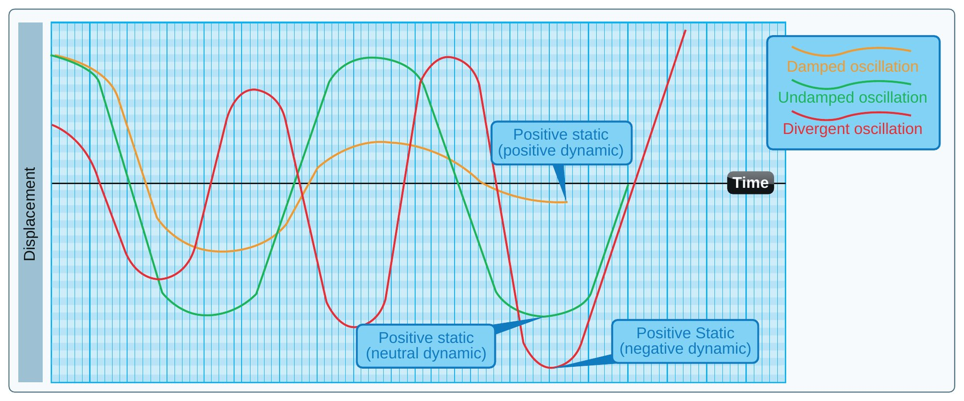
Dynamic Stability
AI.II.D.K2
Response over time
Positive: motion gets smaller
Neutral: motion stays the same
Negative: motion grows
Dynamic stability refers to the aircraft response over time when disturbed (PHAK 5-14).
Positive: the motion decreases in amplitude and returns toward equilibrium. Neutral: the motion neither decreases nor increases. Negative: the motion increases and becomes more divergent (PHAK 5-15).
KNOW THIS FOR THE CHECKRIDE
Static stability is the first reaction. Dynamic stability is what happens over time.
THINK OF IT LIKE THIS
a worn automobile shock absorber shows neutral dynamic stability. The car keeps bouncing the same amount (PHAK 5-15).
Source: PHAK 5-14, PHAK 5-15, PHAK Fig 5-22
13
Notes:
Dynamic stability is what happens over time. The PHAK uses a worn shock absorber as the neutral example.

Slide 14
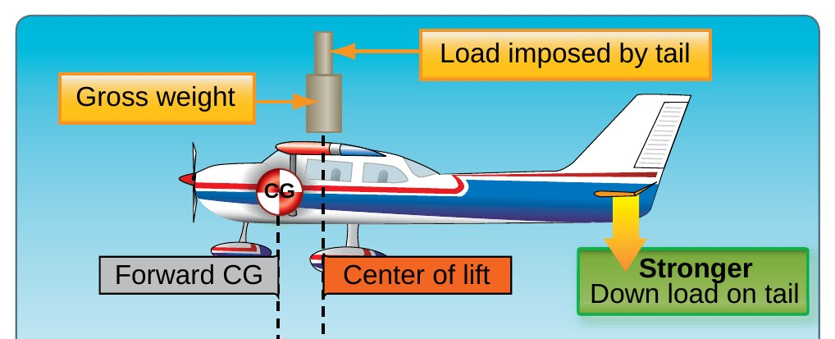
Definitions: Maneuverability and Controllability
AI.II.D.K2
MANEUVERABILITY
“the quality of an aircraft that permits it to be maneuvered easily and to withstand the stresses imposed by maneuvers. It is governed by the aircraft's weight, inertia, size and location of flight controls, structural strength, and powerplant.”
CONTROLLABILITY
“the capability of an aircraft to respond to the pilot's control, especially with regard to flight path and attitude.”
IN PLAIN WORDS
Maneuverability: how easily the airplane can be maneuvered and handle the stress. Controllability: how well it does what the pilot asks.
Source: PHAK 5-15, PHAK Fig 5-63
14
Notes:
Read both definitions. The PHAK says stability affects these two areas.

Slide 15
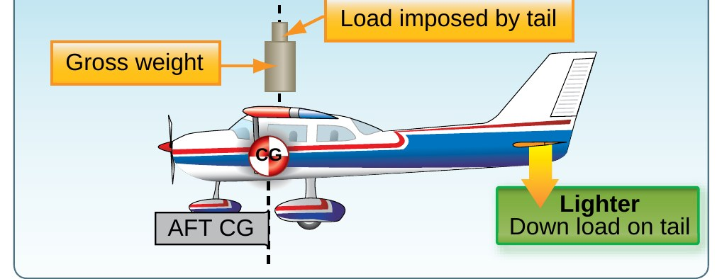
Putting the Three Together
AI.II.D.K2
Stability: wants to return
Maneuverability: maneuvers easily
Controllability: answers the pilot
CG location changes all three
A trainer like the C172S is quick to respond to control inputs, while a transport feels heavy and responds slowly. Designers balance these qualities for the airplane's purpose (PHAK 5-14).
CG location ties it together: an aircraft becomes less controllable at slow speeds and less stable as the CG moves aft (PHAK 5-43, PHAK 5-44).
Source: PHAK 5-15, PHAK 5-43, PHAK 5-44
15
Notes:
More stability means a steadier airplane but more effort to maneuver. CG location is the part the pilot controls.

Slide 16
Quick Check
AI.II.D.K2
1
A ball resting on a flat table shows which static stability?
Answer: Neutral. It stays in its new position (PHAK 5-14).
2
The airplane oscillates and each swing gets bigger. What is that?
Answer: Negative dynamic stability (PHAK 5-15).
3
The CG moves aft. More stable or less stable?
Answer: Less stable (PHAK 5-44).
Source: PHAK 5-14, PHAK 5-15, PHAK 5-44
16
Notes:
Ask each question and let the student answer before showing the answer. Q1: A ball resting on a flat table shows which static stability? A: Neutral. It stays in its new position (PHAK 5-14). Q2: The airplane oscillates and each swing gets bigger. What is that? A: Negative dynamic stability (PHAK 5-15). Q3: The CG moves aft. More stable or less stable? A: Less stable (PHAK 5-44).

Slide 17
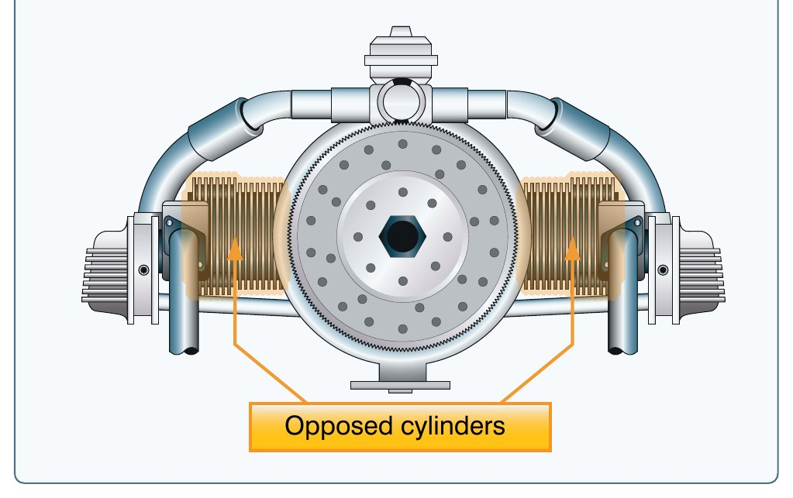
AI.II.E.K1c
Powerplant and Propeller
What you will learn
The C172S engine
Throttle and mixture
How a propeller works
Fixed pitch and the tachometer
Why it matters: you have to explain the engine and prop of the airplane you fly, and the C172S is simpler than most study guides describe.
Source: POH 7-28, POH 7-36, PHAK 7-1 to 7-5
17
Notes:
Section: Powerplant and Propeller. Why it matters: you have to explain the engine and prop of the airplane you fly, and the C172S is simpler than most study guides describe.

Slide 18
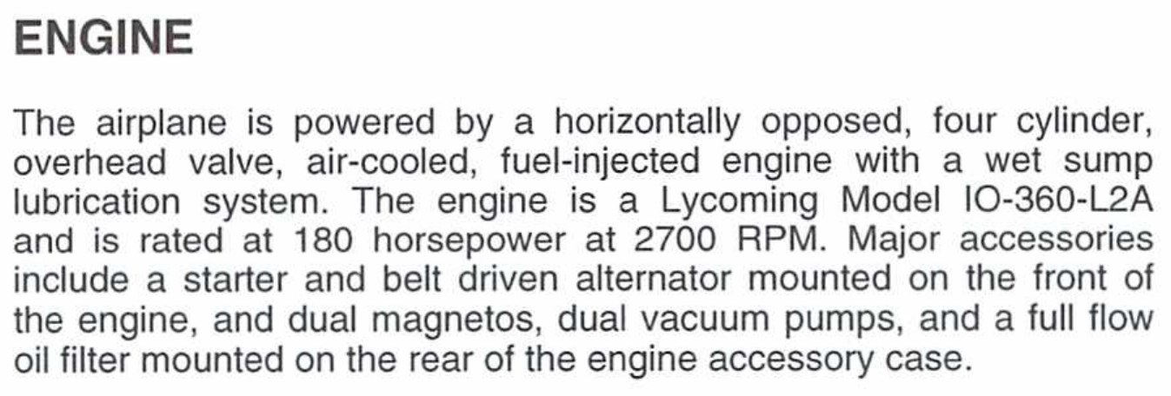
C172S Engine
AI.II.E.K1c
Lycoming IO-360-L2A
180 hp at 2,700 RPM
Four cylinder, horizontally opposed
Fuel injected, air cooled
An aircraft engine, or powerplant, produces thrust to propel an aircraft. Reciprocating engines work with a propeller to produce thrust (PHAK 7-1).
C172S: horizontally opposed, four cylinder, overhead valve, air-cooled, fuel-injected engine with a wet sump lubrication system. Lycoming IO-360-L2A rated at 180 horsepower at 2,700 RPM (POH 7-28, TCDS 3A12 p30).
Horizontally opposed engines have high power-to-weight ratios and a small frontal area (PHAK 7-2).
KNOW THIS FOR THE CHECKRIDE
Lycoming IO-360-L2A, 180 hp at 2,700 RPM, four cylinder, horizontally opposed, fuel injected (POH 7-28).
Source: POH 7-28, TCDS 3A12 p30, PHAK 7-2
18
Notes:
The POH describes a horizontally opposed, four cylinder, overhead valve, air cooled, fuel injected engine with a wet sump.

Slide 19
Engine Controls
AI.II.E.K1c
Throttle: fuel-air flow, RPM
Mixture: red knob
Mixture full aft: idle cutoff
No propeller control
Throttle: open full forward, closed full aft. In a fixed-pitch airplane, rpm is regulated by the throttle, which controls the fuel-air flow to the engine (POH 7-28, PHAK 7-5).
Mixture: red knob with a lock button. Rich is full forward, idle cutoff is full aft (POH 7-28).
Study guide fix: the guide says the throttle regulates fuel flow and lists a propeller control. The PHAK says fuel-air flow, and the C172S has a fixed-pitch propeller with no propeller control.
KNOW THIS FOR THE CHECKRIDE
The throttle controls fuel-air flow and RPM. The C172S has no propeller control.
Source: POH 7-28, PHAK 7-5
19
Notes:
Correction to the study guide: the throttle controls fuel-air flow, not just fuel. And the C172S has no propeller control.

Slide 20
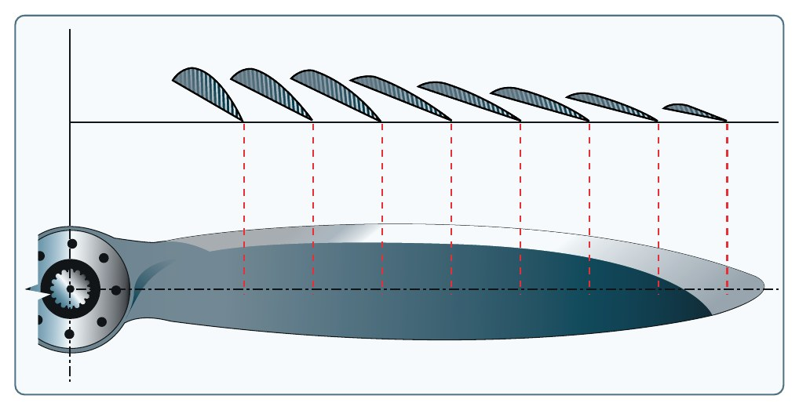
Definitions: Propeller and Fixed Pitch
AI.II.E.K1c
PROPELLER
“The propeller is a rotating airfoil, subject to induced drag, stalls, and other aerodynamic principles that apply to any airfoil.”
FIXED-PITCH PROPELLER
“A propeller with fixed blade angles is a fixed-pitch propeller. The pitch of this propeller is set by the manufacturer and cannot be changed.”
IN PLAIN WORDS
The propeller is a spinning wing that pulls the airplane forward. On the C172S the blade angle is set at the factory and never changes.
Source: PHAK 7-4, PHAK 7-5, PHAK Fig 7-6
20
Notes:
Read both. The blade is twisted so it makes even lift from hub to tip.

Slide 21
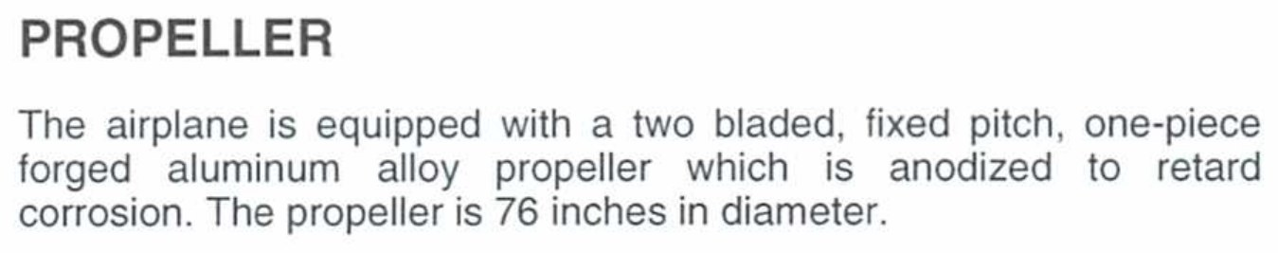
C172S Propeller
AI.II.E.K1c
Two blade, fixed pitch
76 inch forged aluminum
Best at one speed, rpm
Tachometer shows power
C172S: two bladed, fixed pitch, one-piece forged aluminum alloy propeller, 76 inches in diameter (POH 7-36).
A fixed-pitch propeller is most efficient only at one combination of airspeed and rpm, so it is ideal for neither cruise nor climb. It is used when low weight, simplicity, and low cost are needed (PHAK 7-5).
Propeller efficiency is the ratio of thrust horsepower to brake horsepower (PHAK 5-29). In plain words: the engine makes power, and the propeller turns part of it into thrust.
KNOW THIS FOR THE CHECKRIDE
Fixed pitch means the tachometer is your power gauge (PHAK 7-5).
Source: POH 7-36, PHAK 7-5, PHAK 5-29
21
Notes:
Fixed pitch is simple and light, but it is only most efficient at one combination of airspeed and rpm.

Slide 22
Quick Check
AI.II.E.K1c
1
What engine does the C172S have, and how much power?
Answer: Lycoming IO-360-L2A, 180 hp at 2,700 RPM (POH 7-28).
2
What instrument shows engine power in the C172S?
Answer: The tachometer (PHAK 7-5).
3
Why is the propeller blade twisted?
Answer: For even lift from hub to tip, because the tip travels faster (PHAK 7-4).
Source: POH 7-28, PHAK 7-4, PHAK 7-5
22
Notes:
Ask each question and let the student answer before showing the answer. Q1: What engine does the C172S have, and how much power? A: Lycoming IO-360-L2A, 180 hp at 2,700 RPM (POH 7-28). Q2: What instrument shows engine power in the C172S? A: The tachometer (PHAK 7-5). Q3: Why is the propeller blade twisted? A: For even lift from hub to tip, because the tip travels faster (PHAK 7-4).

Slide 23
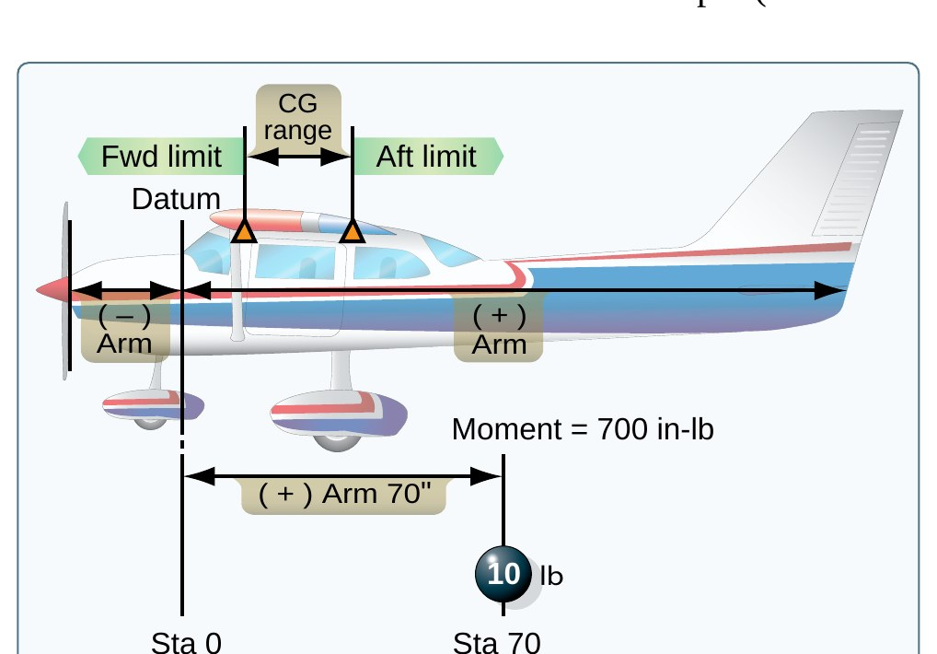
AI.II.F.K3
Weight and Balance Terms
What you will learn
Datum and arm
Moment and CG
Basic empty weight and useful load
CG limits and maximum weight
Why it matters: examiners ask for these word for word. Learn the PHAK wording, then the plain words.
Source: PHAK 10-4, PHAK 10-5
23
Notes:
Section: Weight and Balance Terms. Why it matters: examiners ask for these word for word. Learn the PHAK wording, then the plain words.

Slide 24
Definitions: Datum and Arm
AI.II.F.K3
DATUM (REFERENCE DATUM)
“an imaginary vertical plane or line from which all measurements of arm are taken. The datum is established by the manufacturer. Once the datum has been selected, all moment arms and the location of CG range are measured from this point.”
ARM (MOMENT ARM)
“the horizontal distance in inches from the reference datum line to the CG of an item. The algebraic sign is plus (+) if measured aft of the datum and minus (−) if measured forward of the datum.”
IN PLAIN WORDS
The datum is the zero point on a tape measure. The arm is how far each seat, tank, or bag sits from that zero point.
Source: PHAK 10-4, PHAK 10-5, PHAK Fig 10-2
24
Notes:
These are the PHAK definitions. The study guide paraphrased them, so learn the PHAK wording.

Slide 25
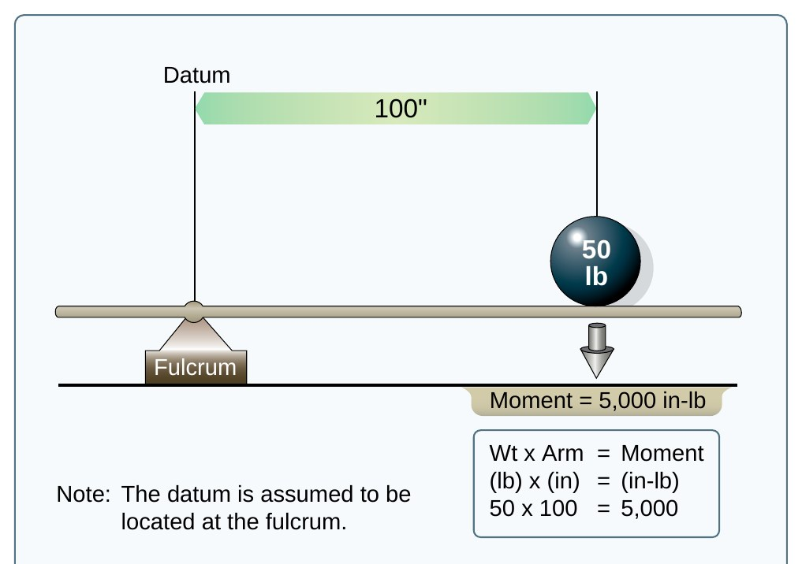
Definitions: Moment and CG
AI.II.F.K3
MOMENT
“the product of the weight of an item multiplied by its arm. Moments are expressed in pound-inches (in-lb).”
CENTER OF GRAVITY (CG)
“the point about which an aircraft would balance if it were possible to suspend it at that point.”
IN PLAIN WORDS
Moment is how hard a weight tries to tip the airplane. The CG is the balance point of everything combined.
Source: PHAK 10-4, PHAK 10-5, PHAK Fig 10-3
25
Notes:
Moment is weight times arm. CG is total moment divided by total weight.

Slide 26
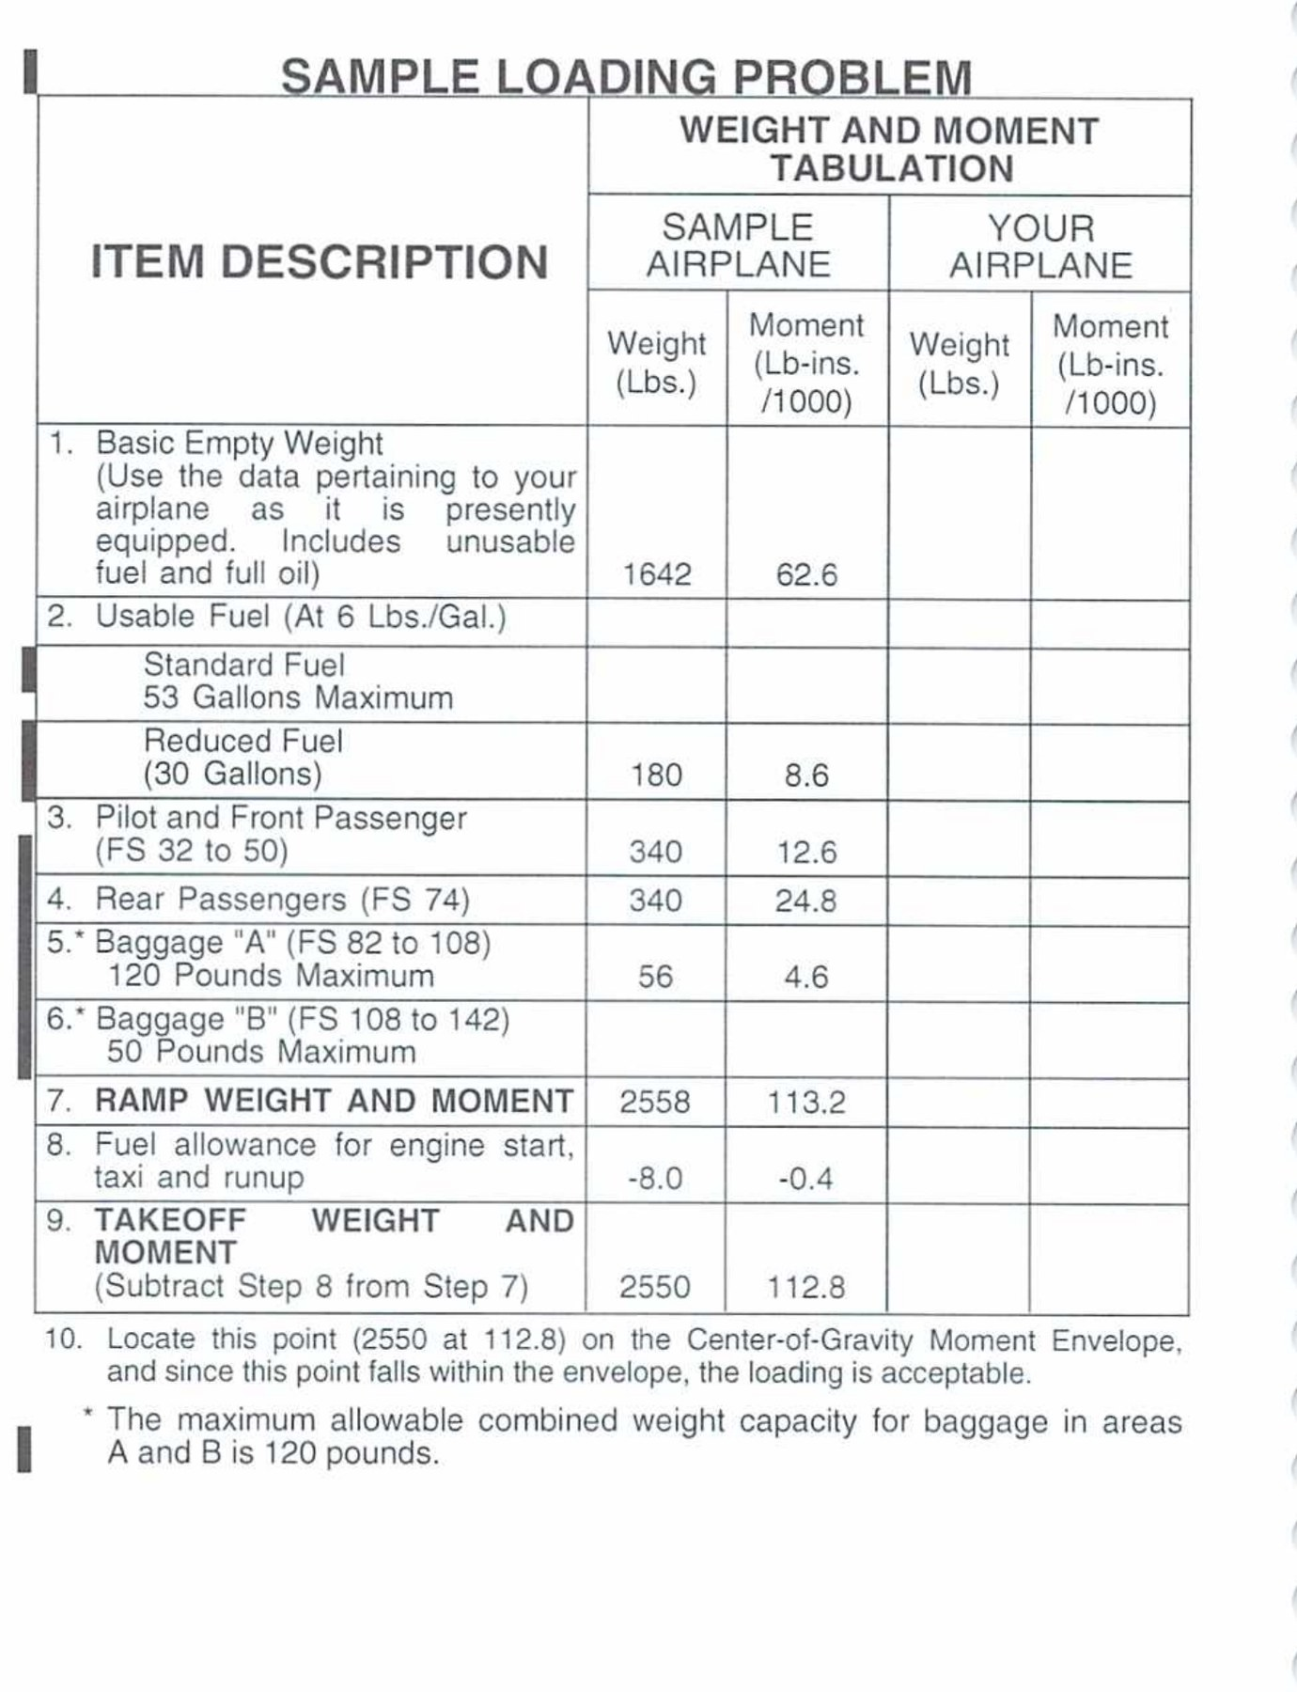
Definitions: Basic Empty Weight and Useful Load
AI.II.F.K3
BASIC EMPTY WEIGHT (GAMA)
“the standard empty weight plus the weight of optional and special equipment that have been installed.”
USEFUL LOAD
“the weight of the pilot, copilot, passengers, baggage, usable fuel, and drainable oil. It is the basic empty weight subtracted from the maximum allowable gross weight.”
IN PLAIN WORDS
Basic empty weight is the airplane with unusable fuel and full oil, nothing else. Useful load is what is left for people, bags, and fuel.
Source: PHAK 10-4, PHAK 10-5, POH Fig 6-3
26
Notes:
Basic empty weight is line 1 of the POH loading problem. Useful load is everything you can add.

Slide 27
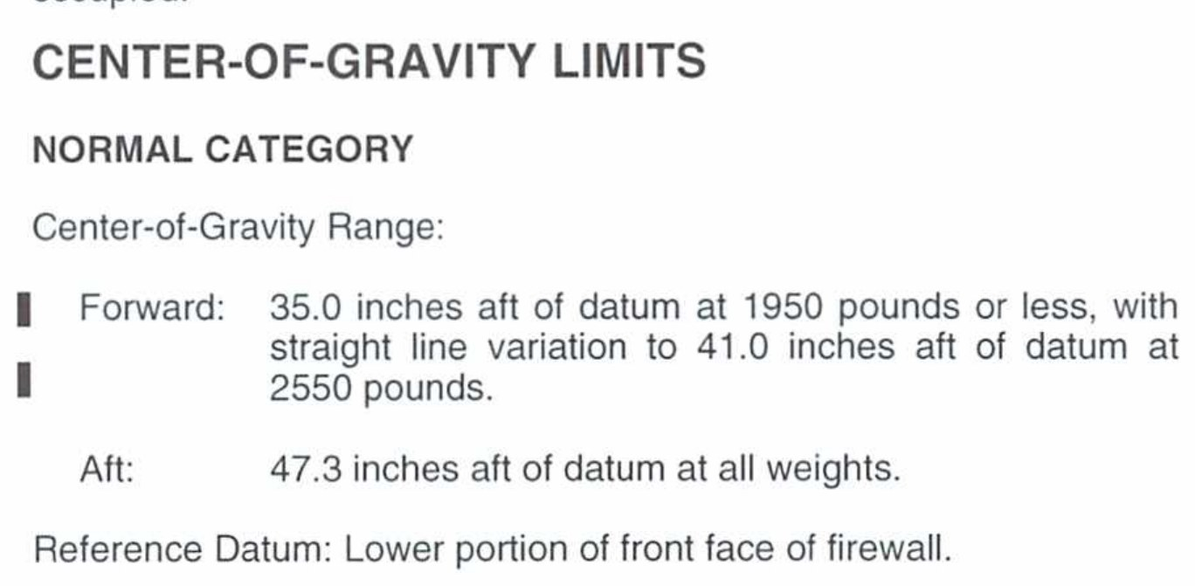
Definitions: CG Limits and Maximum Weight
AI.II.F.K3
CG LIMITS
“the specified forward and aft points within which the CG must be located during flight. These limits are indicated on pertinent aircraft specifications.”
MAXIMUM WEIGHT
“the maximum authorized weight of the aircraft and all of its equipment as specified in the TCDS for the aircraft.”
IN PLAIN WORDS
CG limits are the front and back edges of the safe balance zone. Maximum weight is the heaviest the airplane may be.
Source: PHAK 10-5, POH 2-8
27
Notes:
The ACS says maximum gross weight. The PHAK term is maximum weight.

Slide 28
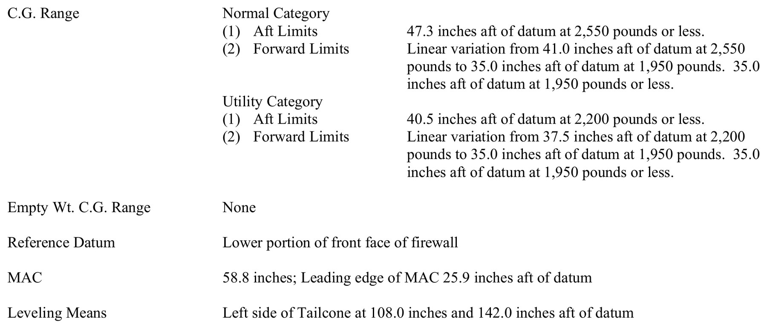
C172S Weight and Balance Numbers
AI.II.F.K3
Datum: front face of firewall
Max takeoff: 2,550 lb
CG: 35.0 to 47.3 in
CG = moment / weight
Normal category: maximum takeoff and landing weight 2,550 lb, ramp 2,558 lb (POH 2-8). Forward CG limit 35.0 inches at 1,950 lb or less, straight line to 41.0 inches at 2,550 lb. Aft limit 47.3 inches at all weights (POH 2-8, TCDS 3A12 p30).
Full detail and worked problems are in the II.F Performance and Limitations lesson.
MEMORY AID
Moment = Weight x Arm. CG = Total Moment / Total Weight.
Source: TCDS 3A12 p30, POH 2-8, PHAK 10-7
28
Notes:
The forward limit moves aft as weight goes up: 35.0 inches at 1,950 lb or less, up to 41.0 inches at 2,550 lb. Aft limit is 47.3 at all weights.

Slide 29
Quick Check
AI.II.F.K3
1
Where is the C172S datum?
Answer: Lower portion of the front face of the firewall (TCDS 3A12 p30).
2
A 120 lb bag is 95 inches aft of the datum. What is its moment?
Answer: 120 x 95 = 11,400 in-lb.
3
Basic empty weight is 1,642 lb and maximum weight is 2,550 lb. What is the useful load?
Answer: 908 lb.
Source: TCDS 3A12 p30, PHAK 10-6, POH 6-10
29
Notes:
Ask each question and let the student answer before showing the answer. Q1: Where is the C172S datum? A: Lower portion of the front face of the firewall (TCDS 3A12 p30). Q2: A 120 lb bag is 95 inches aft of the datum. What is its moment? A: 120 x 95 = 11,400 in-lb. Q3: Basic empty weight is 1,642 lb and maximum weight is 2,550 lb. What is the useful load? A: 908 lb.

Slide 30
AI.II.H.K1
Ground-Based Navigation
What you will learn
Identify a VOR
Read the CDI and HSI
Track a radial in wind
VOR checks, NDB, interference
Why it matters: when GPS fails, the VOR is your backup. Your students need to use it without reverse sensing mistakes.
Source: AIM 1-1-2 to 1-1-4, PHAK 16-23 to 16-26
30
Notes:
Section: Ground-Based Navigation. Why it matters: when GPS fails, the VOR is your backup. Your students need to use it without reverse sensing mistakes.

Slide 31
VOR: Identification and Accuracy
AI.II.H.K1
108.0 to 117.95 MHz
Line of sight only
Identify by Morse code
Accuracy: about 1 degree
VORs operate from 108.0 to 117.95 MHz and are subject to line-of-sight limits. Range increases with altitude (AIM 1-1-3).
Identification: the only positive method is the Morse code identifier or the recorded voice identification with the word "VOR" after the name. During maintenance the station may send T-E-S-T or remove the identifier (AIM 1-1-3).
Accuracy: course alignment is generally plus or minus 1 degree (AIM 1-1-3).
Source: AIM 1-1-3, PHAK Fig 16-29
31
Notes:
The only positive way to identify a VOR is its Morse code or the recorded voice ID that says VOR after the name.

Slide 32
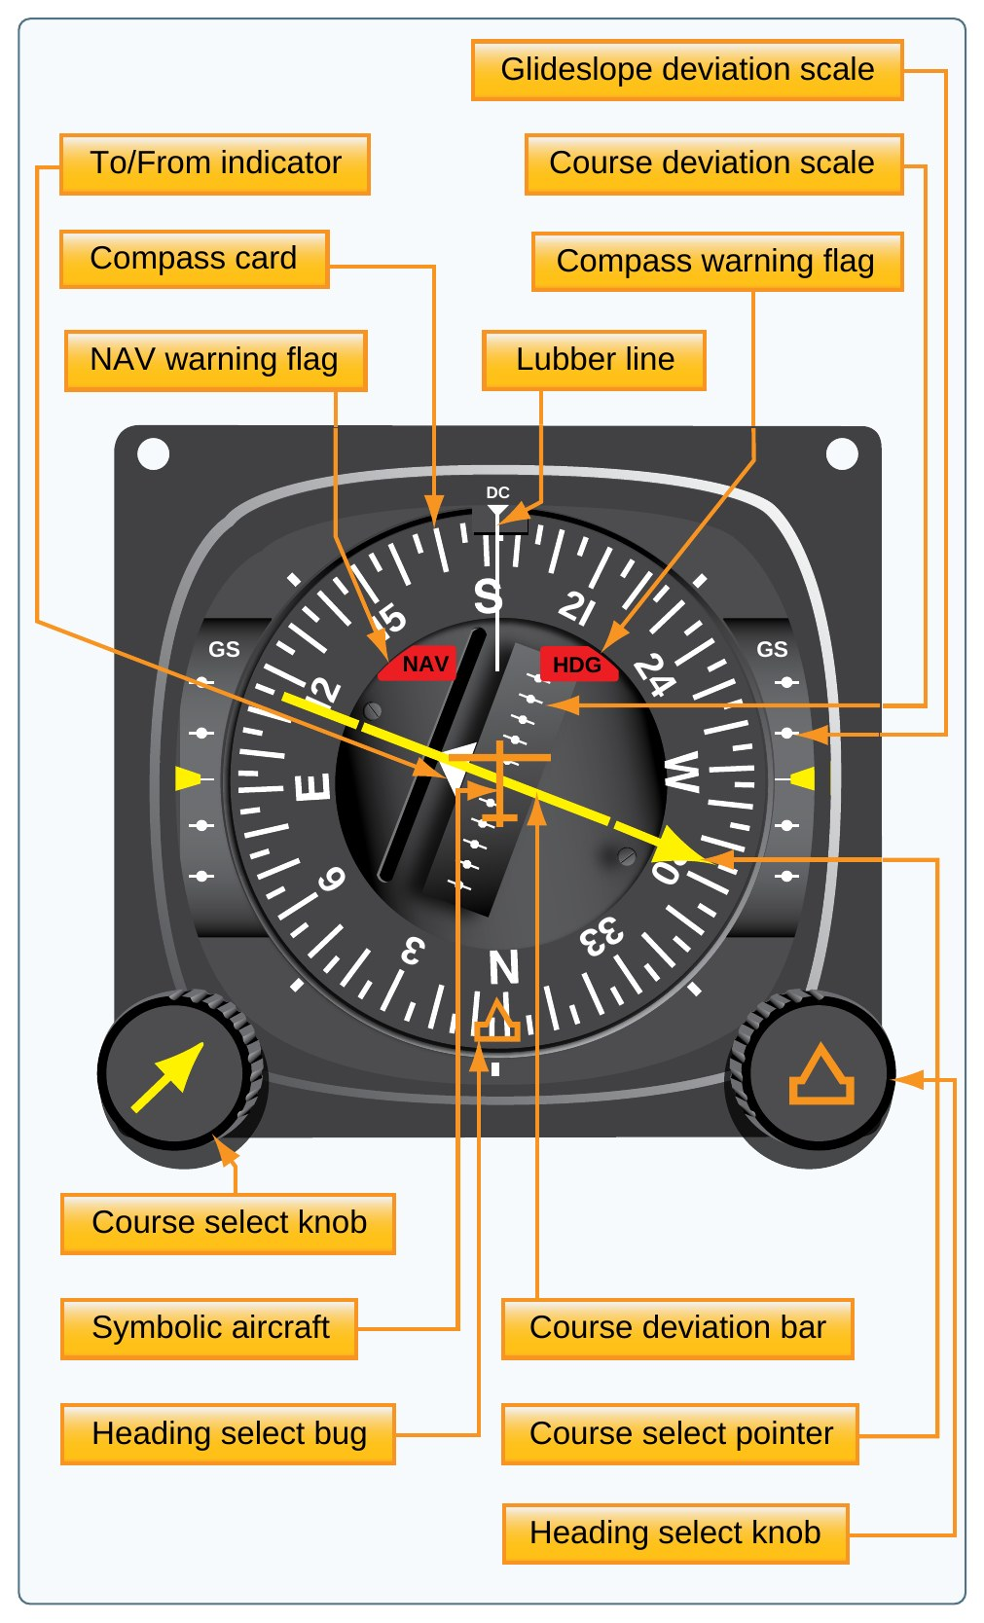
Orientation: CDI and HSI
AI.II.H.K1
OBS sets the course
Needle shows course deviation
TO/FROM shows station side
G1000 shows an HSI
The CDI has an omnibearing selector (OBS), a course deviation needle, and a TO/FROM indicator (PHAK 16-23).
The HSI combines the heading indicator and the CDI in one display, which is how the G1000 PFD presents it (PHAK 16-24).
Reverse sensing: fly the selected course with a TO indication when going to a station and FROM when going away. If not, the needle works backward (PHAK 16-26).
Study guide fix: the guide says to correct reverse sensing by turning away from the needle. The PHAK way is to set the course so the TO/FROM matches your direction, and then the needle reads normally.
KNOW THIS FOR THE CHECKRIDE
Fly TO when going to the station and FROM when going away, or the needle reverses (PHAK 16-26).
Source: PHAK 16-23, PHAK 16-24, PHAK 16-26, PHAK Fig 16-30
32
Notes:
The C172S G1000 shows VOR on the HSI. Same idea as a CDI: select a course, the needle shows where that course is.

Slide 33
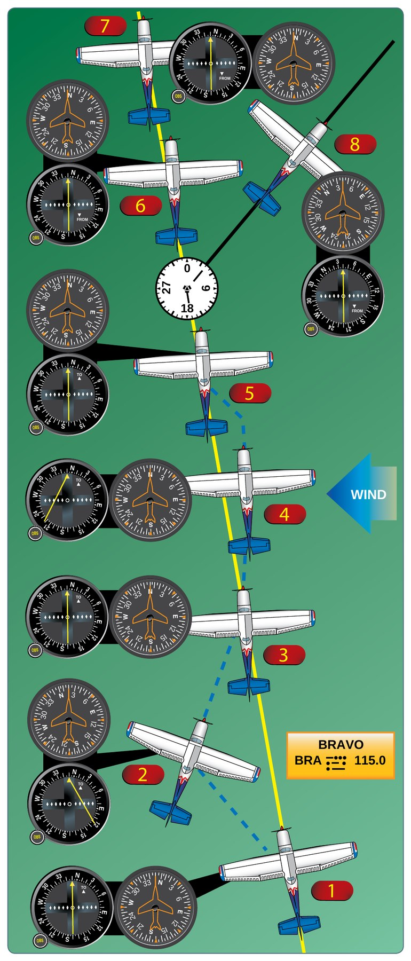
Course Determination: Tracking
AI.II.H.K1
Needle shows the course
Turn toward needle, intercept
Hold a wind correction
Wait on small wiggles
PHAK example: holding 350 degrees with wind from the right, the airplane drifts left and the needle moves right. Turn right to return, then turn back toward the course with a wind correction (PHAK 16-25).
Just turning toward the needle causes overshooting and S-turns. Fly headings that re-intercept, then apply a drift correction. If the needle fluctuates slightly, wait before changing heading (PHAK 16-26).
Station passage: the needle fluctuates, then the TO changes to FROM (PHAK 16-25).
REAL WORLD SCENARIO
Your student keeps chasing the needle and flies S-turns down the radial. Show them how to bracket and hold a wind correction.
Source: PHAK 16-25, PHAK 16-26, PHAK Fig 16-32
33
Notes:
In the PHAK example, wind from the right drifts the airplane left, so the needle moves right. Turn right to get back, then hold a smaller correction.

Slide 34
Tests and Regulations
AI.II.H.K1
VOT: 0 FROM or 180 TO
Ground check: 4 degrees
Airborne check: 6 degrees
IFR: checked within 30 days
14 CFR 91.171 requires a VOR check within the preceding 30 days for IFR. Limits: VOT or ground checkpoint plus or minus 4 degrees, airborne checkpoint plus or minus 6 degrees, dual VOR check 4 degrees between the two (14 CFR 91.171).
Using a VOT: with the CDI centered, the OBS should read 0 degrees FROM or 180 degrees TO (AIM 1-1-4).
Locations of VOTs and checkpoints are in the Chart Supplement (AIM 1-1-4).
KNOW THIS FOR THE CHECKRIDE
Ground check: 4 degrees. Airborne check: 6 degrees. Dual VOR: 4 degrees. Within 30 days for IFR (14 CFR 91.171).
Source: 14 CFR 91.171, AIM 1-1-4
34
Notes:
The VOR check is required for IFR. VFR pilots should still know it. Record date, place, error, and sign.

Slide 35
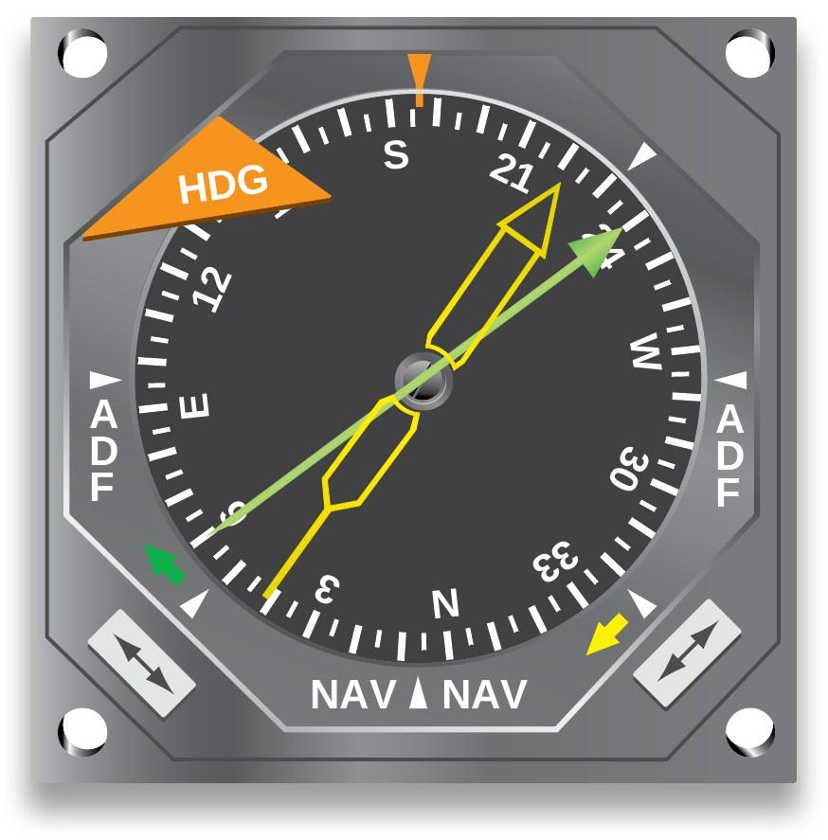
NDB and ADF
AI.II.H.K1
190 to 535 kHz
ADF needle points to station
No warning flag
Keep listening to the ID
NDBs normally operate from 190 to 535 kHz and send a continuous three-letter Morse identifier, except compass locators (AIM 1-1-2).
ADF receivers do not have a flag to warn of bad bearing information, so the pilot should continuously monitor the NDB identifier (AIM 1-1-2).
The RMI shows ADF and VOR bearings with pointers on a compass card (PHAK 16-25).
KNOW THIS FOR THE CHECKRIDE
The ADF has no warning flag. Keep listening to the identifier (AIM 1-1-2).
Source: AIM 1-1-2, PHAK 16-25, PHAK Fig 16-31
35
Notes:
The C172S G1000 may not have an ADF. Know it anyway. The big risk: the ADF has no flag, so a bad bearing looks normal.

Slide 36
Interference and Signal Integrity
AI.II.H.K1
Prop RPM can swing CDI
Change RPM slightly
Flag means unreliable signal
NDB: lightning, night static
Certain propeller rpm settings can make the CDI fluctuate as much as plus or minus 6 degrees. Slight rpm changes normally smooth it out. Check this before reporting a station or receiver problem (AIM 1-1-3).
Minor course roughness or brief flag activity can occur, especially in mountains. Use the TO/FROM indicator to confirm station passage (AIM 1-1-3).
NDB bearings can be disturbed by lightning, precipitation static, and distant stations at night (AIM 1-1-2).
Appropriate use of navigation data: when equipment decodes and displays the identifier, compare it to the chart (AIM 1-1-3).
Source: AIM 1-1-2, AIM 1-1-3
36
Notes:
Before reporting a bad VOR, try a slight RPM change. Some RPM settings make the CDI swing up to 6 degrees.

Slide 37
Quick Check
AI.II.H.K1
1
What is the only positive way to identify a VOR?
Answer: Its Morse code identifier or recorded voice ID with the word "VOR" (AIM 1-1-3).
3
The CDI swings back and forth at one RPM. What do you try first?
Answer: Change the RPM slightly (AIM 1-1-3).
2
With the CDI centered on a VOT, what should the OBS read?
Answer: 0 FROM or 180 TO (AIM 1-1-4).
4
Why must you keep listening to an NDB identifier?
Answer: The ADF has no warning flag for bad bearings (AIM 1-1-2).
Source: AIM 1-1-3, AIM 1-1-4, AIM 1-1-2
37
Notes:
Ask each question and let the student answer before showing the answer. Q1: What is the only positive way to identify a VOR? A: Its Morse code identifier or recorded voice ID with the word "VOR" (AIM 1-1-3). Q2: With the CDI centered on a VOT, what should the OBS read? A: 0 FROM or 180 TO (AIM 1-1-4). Q3: The CDI swings back and forth at one RPM. What do you try first? A: Change the RPM slightly (AIM 1-1-3). Q4: Why must you keep listening to an NDB identifier? A: The ADF has no warning flag for bad bearings (AIM 1-1-2).

Slide 38
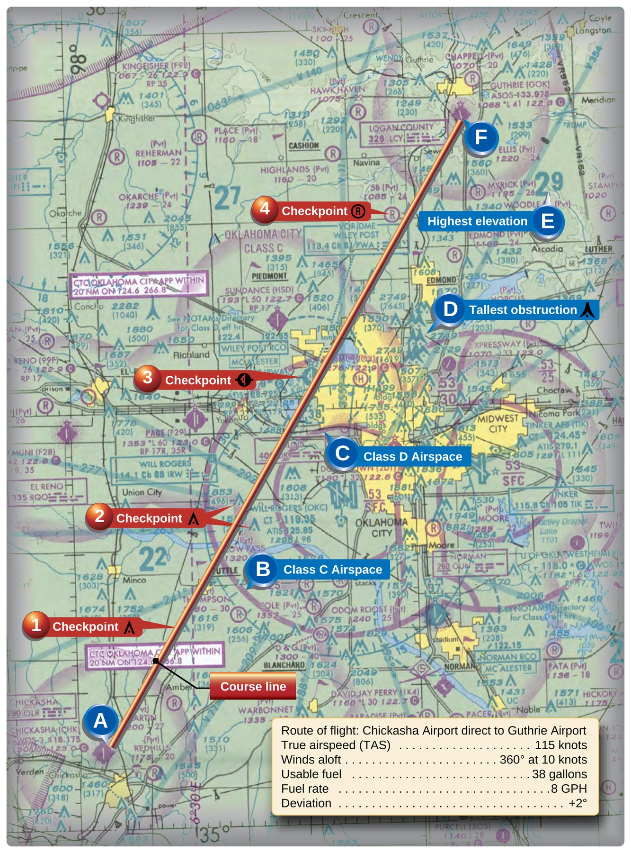
AI.II.I.K3
Plotting a Course
What you will learn
True course
Using the plotter
Magnetic variation
True to magnetic
Why it matters: every nav log starts with a course line. Get the variation backward and you fly the wrong way.
Source: PHAK 16-5 to 16-7, PHAK 16-12, PHAK 16-18
38
Notes:
Section: Plotting a Course. Why it matters: every nav log starts with a course line. Get the variation backward and you fly the wrong way.

Slide 39
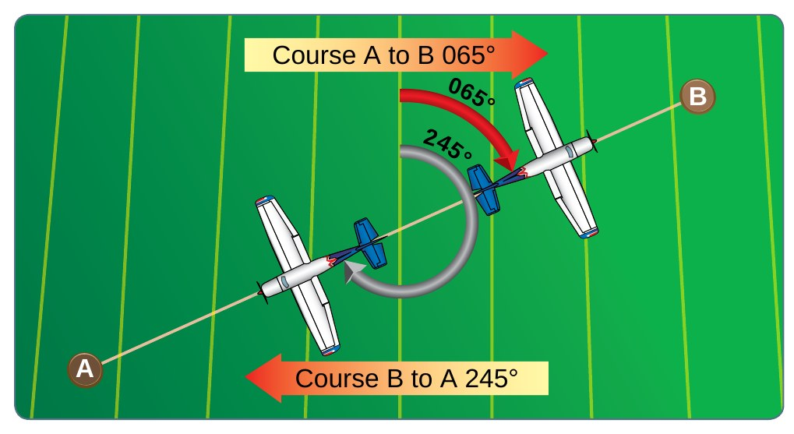
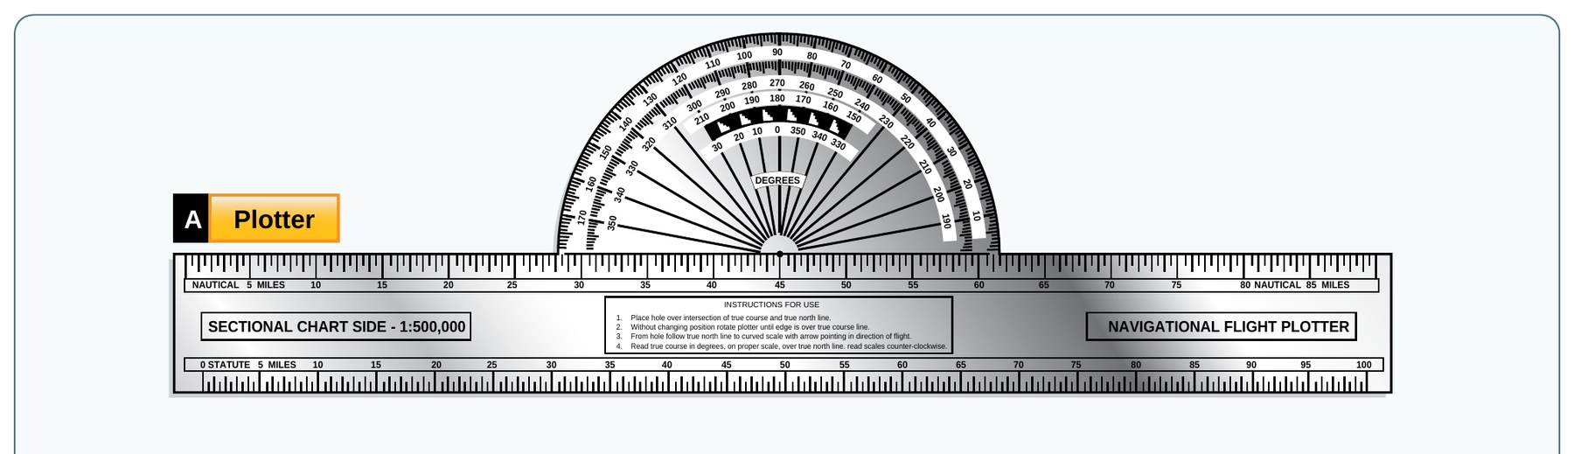
Definition: True Course
AI.II.I.K3
TRUE COURSE (TC)
“The course measured on the chart is known as the true course (TC). This is the direction measured by reference to a meridian or true north (TN).”
IN PLAIN WORDS
The line you draw on the chart, measured from true north with the plotter.
Source: PHAK 16-5, PHAK Fig 16-7
39
Notes:
The plotter measures against meridians, so it gives a true course. The answer to the study guide question is true north.

Slide 40
Plotting the Course
AI.II.I.K3
Line: airport center to center
Measure at midpoint meridian
Plotter gives true course
Measure distance in NM
Draw the course line from the center of the departure airport to the center of the destination (PHAK 16-18).
Because meridians converge toward the poles, measure the course at a meridian near the midpoint of the course (PHAK 16-5).
A plotter is a protractor and ruler. Most have NM and SM scales, with a sectional scale on one side and a world aeronautical chart scale on the other (PHAK 16-12). Use the sectional scale on a sectional chart.
Use nautical miles so distance matches knots for time and fuel. The PHAK fuel example: 400 NM at 100 knots GS = 4 hours, at 5 GPH = 20 gallons (PHAK 16-12).
KNOW THIS FOR THE CHECKRIDE
Knots go with nautical miles. Use the NM scale on the plotter.
Source: PHAK 16-5, PHAK 16-12, PHAK 16-18, PHAK Fig 16-25
40
Notes:
Measure near the middle because meridians get closer together toward the poles. Use the nautical mile scale so it matches knots.

Slide 41
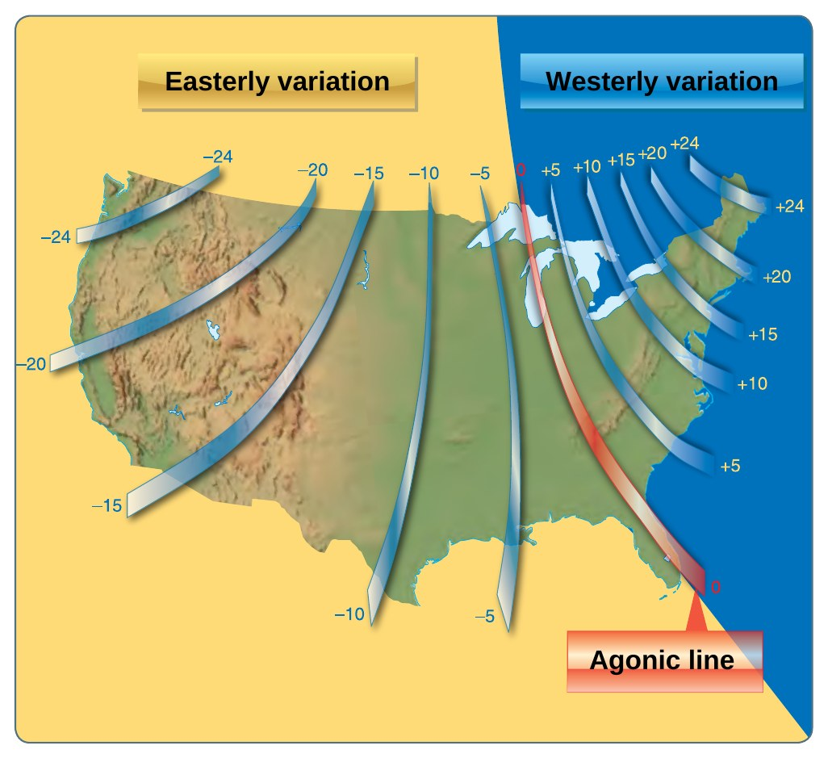
Definition: Variation
AI.II.I.K3
VARIATION
“Variation is the angle between TN and magnetic north (MN). It is expressed as east variation or west variation depending upon whether MN is to the east or west of TN.”
IN PLAIN WORDS
True north and magnetic north are in different places. Variation is the angle between them, and the chart shows how much.
Source: PHAK 16-6, PHAK Fig 16-9
41
Notes:
Variation is printed on the sectional as dashed magenta isogonic lines. The agonic line has zero variation.

Slide 42
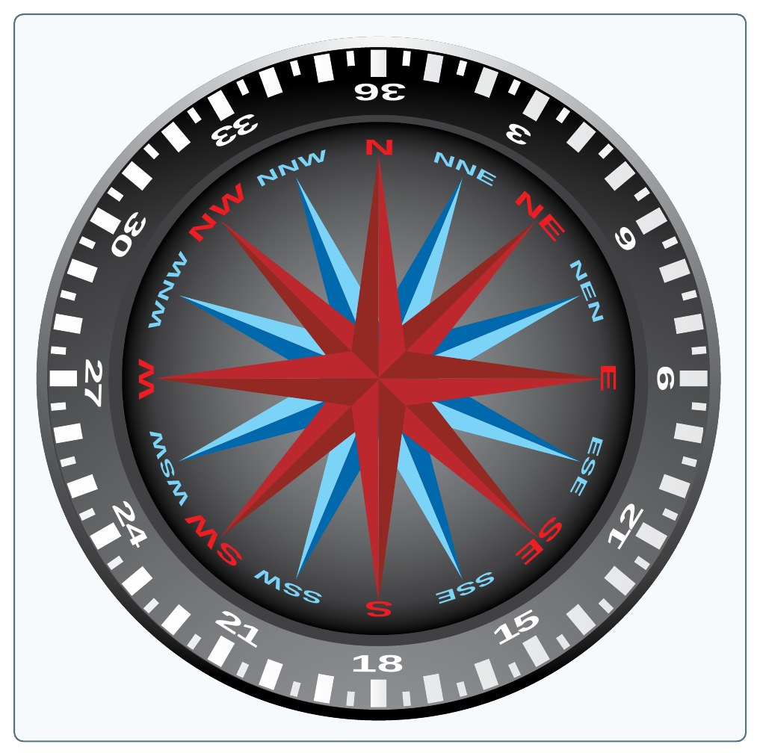
True Course to Magnetic Course
AI.II.I.K3
Use nearest isogonic line
West variation: add
East variation: subtract
East is least, west is best
Convert TC to magnetic course by adding or subtracting the variation from the nearest isogonic line. If variation is west, add. If east, subtract (PHAK 16-7).
PHAK example: variation 9 degrees E. True north 360 becomes magnetic 351. True east 090 becomes magnetic 081 (PHAK 16-7).
If you cross isogonic lines, use the new value from that point on (PHAK 16-7).
MEMORY AID
East is least (subtract). West is best (add) (PHAK 16-7).
Source: PHAK 16-7
42
Notes:
Example from the PHAK: with 9 degrees east, to fly true 090 you fly magnetic 081.

Slide 43
Quick Check
AI.II.I.K3
1
When you measure with a plotter, are you referencing true or magnetic north?
Answer: True north. The result is the true course (PHAK 16-5).
2
True course 090, variation 9 degrees east. Magnetic course?
Answer: 081 (PHAK 16-7).
3
On a long route, where do you measure the course?
Answer: At a meridian near the midpoint (PHAK 16-5).
Source: PHAK 16-5, PHAK 16-7
43
Notes:
Ask each question and let the student answer before showing the answer. Q1: When you measure with a plotter, are you referencing true or magnetic north? A: True north. The result is the true course (PHAK 16-5). Q2: True course 090, variation 9 degrees east. Magnetic course? A: 081 (PHAK 16-7). Q3: On a long route, where do you measure the course? A: At a meridian near the midpoint (PHAK 16-5).

Slide 44
AI.II.I.K4
Power Setting Selection
What you will learn
Use the POH cruise tables
Power in a fixed-pitch airplane
Read the chart notes
Speed versus fuel
Why it matters: the power setting you pick sets your speed, fuel burn, and range for the whole trip.
Source: POH 4-33 to 4-35, POH Fig 5-8, PHAK 7-5
44
Notes:
Section: Power Setting Selection. Why it matters: the power setting you pick sets your speed, fuel burn, and range for the whole trip.

Slide 45
Choosing a Power Setting
AI.II.I.K4
Start with POH cruise table
Pick altitude with best winds
Low power saves fuel
High power: faster, more fuel
The Cruise Performance Table shows true airspeed and nautical miles per gallon at various altitudes and percent powers, for standard conditions and zero wind. Use it with winds aloft to find the most favorable altitude and power setting (POH 4-33).
The POH says choosing altitude for the best winds and using low power settings are significant factors to reduce fuel use on every trip (POH 4-33).
Example from Figure 4-3: at 8,000 feet, 75 percent gives 124 KTAS at 12.2 NMPG and 55 percent gives 107 KTAS at 13.6 NMPG (POH 4-33).
Fuel burn also depends on engine condition, rpm, mixture, and percent of horsepower used (PHAK 16-12).
KNOW THIS FOR THE CHECKRIDE
Pick the altitude with the best winds, then pick the power. Lower power saves fuel (POH 4-33).
Source: POH 4-33, PHAK 16-12
45
Notes:
The POH says use this table with the winds aloft to choose the best altitude and power setting for the trip.

Slide 46
Power in a Fixed-Pitch Airplane
AI.II.I.K4
Tachometer shows engine power
Same RPM: less power up high
Percent of max continuous power
Above 75%: full rich
In a fixed-pitch propeller airplane, the tachometer is the indicator of engine power (PHAK 7-5).
Power depends on air density. 2,300 rpm at 5,000 feet produces less horsepower than 2,300 rpm at sea level (PHAK 7-5).
The POH cruise data is based on the recommended lean mixture at 75 percent Maximum Continuous Power (MCP) and less (POH 4-34). Use full rich mixture above 75 percent power (POH 4-35).
Study guide fix: the guide explains brake horsepower as power measured with a brake. That explanation is not in the FAA handbooks. The PHAK uses brake horsepower as engine power and says propeller efficiency is thrust horsepower divided by brake horsepower (PHAK 5-29).
REAL WORLD SCENARIO
Your student sets 2,400 RPM at 8,000 feet and expects the same speed as 2,400 RPM at sea level. Ask why the airplane is slower and where to find the real numbers.
Source: PHAK 7-5, POH 4-34, POH 4-35
46
Notes:
2,300 rpm at 5,000 feet makes less power than 2,300 rpm at sea level because the air is thinner. That is why the chart lists rpm by altitude.

Slide 47
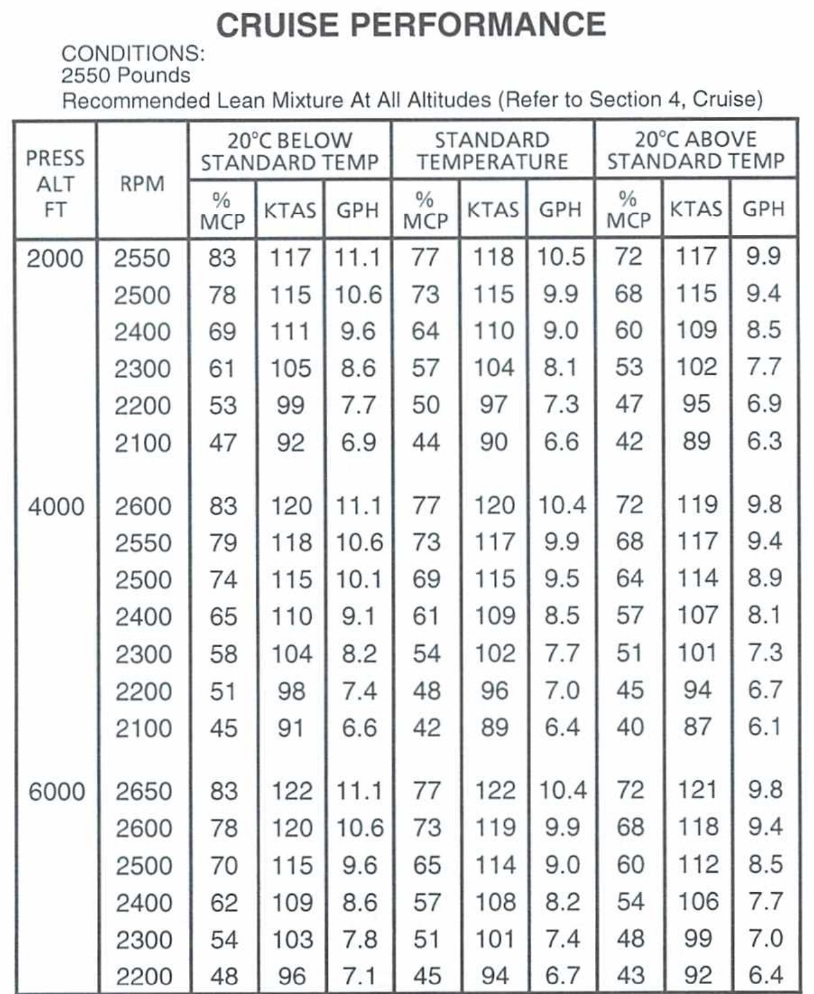
Example: Read the Notes
AI.II.I.K4
8,000 ft, +20 C: 2,600 RPM
64% power, 117 KTAS
Fuel flow: 8.9 GPH
Note: above 75% full rich
POH sample: at 8,000 feet and 20 degrees C above standard, 2,600 RPM gives 64 percent power, 117 KTAS, and 8.9 GPH (POH 5-5).
Figure 5-8 note: maximum cruise power using recommended lean mixture is 75 percent MCP. Values above 75 percent MCP are shown for interpolation only. Operations above 75 percent MCP must use full rich mixture (POH Fig 5-8).
Teach the learner to read the whole chart, including conditions and notes, before choosing a setting.
KNOW THIS FOR THE CHECKRIDE
Always read the chart notes before you choose a power setting.
Source: POH 5-5, POH Fig 5-8
47
Notes:
Your study guide is right that the notes matter. This chart note says above 75 percent MCP is for interpolation only and must use full rich.

Slide 48
Quick Check
AI.II.I.K4
1
What should your student look at first to pick a power setting?
Answer: The POH cruise performance table and charts (POH 4-33).
2
Above 75 percent power, how do you set the mixture?
Answer: Full rich (POH Fig 5-8).
3
Same RPM, higher altitude: more or less power?
Answer: Less, because the air is less dense (PHAK 7-5).
Source: POH 4-33, POH Fig 5-8, PHAK 7-5
48
Notes:
Ask each question and let the student answer before showing the answer. Q1: What should your student look at first to pick a power setting? A: The POH cruise performance table and charts (POH 4-33). Q2: Above 75 percent power, how do you set the mixture? A: Full rich (POH Fig 5-8). Q3: Same RPM, higher altitude: more or less power? A: Less, because the air is less dense (PHAK 7-5).

Slide 49
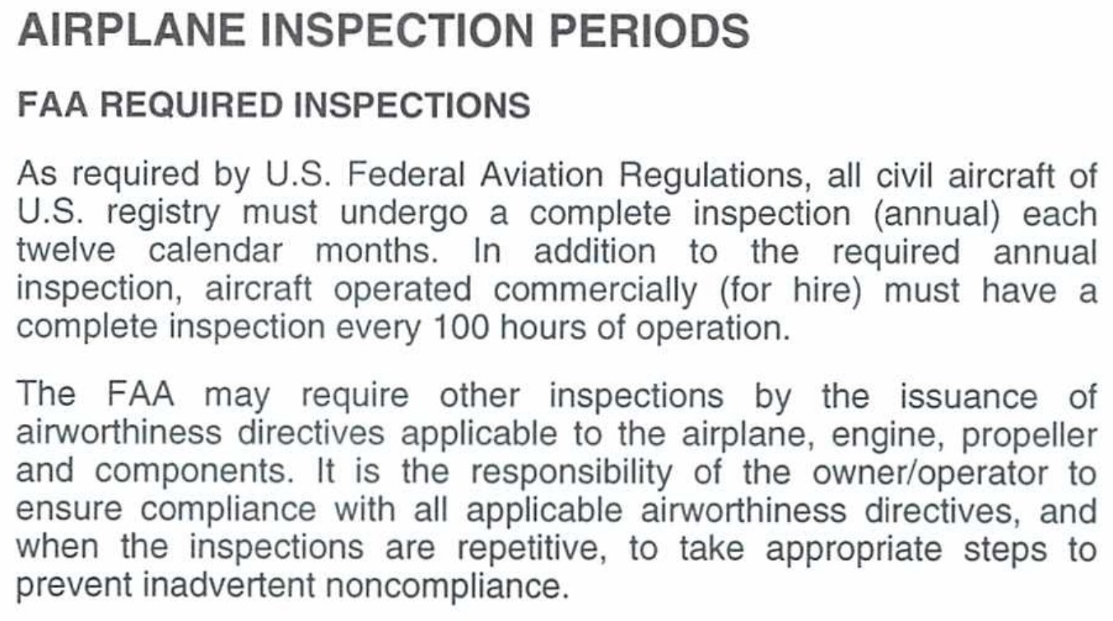
AI.III.B.K1b
Inspections and Logbooks
What you will learn
Annual and 100-hour
Transponder, ELT, other checks
ADs
What goes in the logbook
Why it matters: as a CFI you must confirm the airplane is legal before every lesson. The logbooks are how you prove it.
Source: 14 CFR 91.409, 91.413, 91.417
49
Notes:
Section: Inspections and Logbooks. Why it matters: as a CFI you must confirm the airplane is legal before every lesson. The logbooks are how you prove it.

Slide 50
Required Inspections
AI.III.B.K1b
Annual: 12 calendar months
100-hour: for hire, instruction
May exceed 10 hours to shop
Comply with all ADs
Annual: no person may operate an aircraft unless it has had an annual inspection within the preceding 12 calendar months (14 CFR 91.409). Twelve calendar months runs from any day of a month to the last day of the same month the next year (PHAK 9-8).
100-hour: required to carry any person (other than crew) for hire, or to give flight instruction for hire in an aircraft that person provides. It may be exceeded by not more than 10 hours to reach a place where it can be done, and the extra time counts toward the next 100 hours (14 CFR 91.409).
The owner or operator is primarily responsible for keeping the aircraft airworthy, including compliance with ADs under part 39 (14 CFR 91.403). The POH says the FAA may require other inspections through ADs (POH 8-7).
Note: an amendment to 91.403 and 91.409 was published November 10, 2026 and is not yet in the current text. Recheck before your checkride.
KNOW THIS FOR THE CHECKRIDE
Annual: every 12 calendar months. 100-hour: carrying people for hire, or paid instruction in an airplane you provide.
Source: 14 CFR 91.409, 14 CFR 91.403, PHAK 9-8, POH 8-7
50
Notes:
Annual for everyone. 100-hour if carrying people for hire or giving instruction for hire in an airplane you provide.

Slide 51
Other Required Checks
AI.III.B.K1b
Transponder: 24 calendar months
ELT: 12 calendar months
Altimeter, static: 24 (IFR)
VOR check: 30 days (IFR)
Transponder: tested and inspected within the preceding 24 calendar months (14 CFR 91.413).
ELT: inspected within 12 calendar months after the last inspection (14 CFR 91.207).
Altimeter and static system: tested within 24 months to operate in controlled airspace under IFR (PHAK 9-9).
VOR: checked within the preceding 30 days for IFR (14 CFR 91.171).
MEMORY AID
Transponder 24, ELT 12, altimeter and static 24 (IFR), VOR 30 days (IFR).
Source: 14 CFR 91.413, 14 CFR 91.207, 14 CFR 91.171, PHAK 9-9
51
Notes:
Transponder and ELT apply to every flight. The altimeter and VOR checks are IFR requirements, but a CFI should know them.

Slide 52
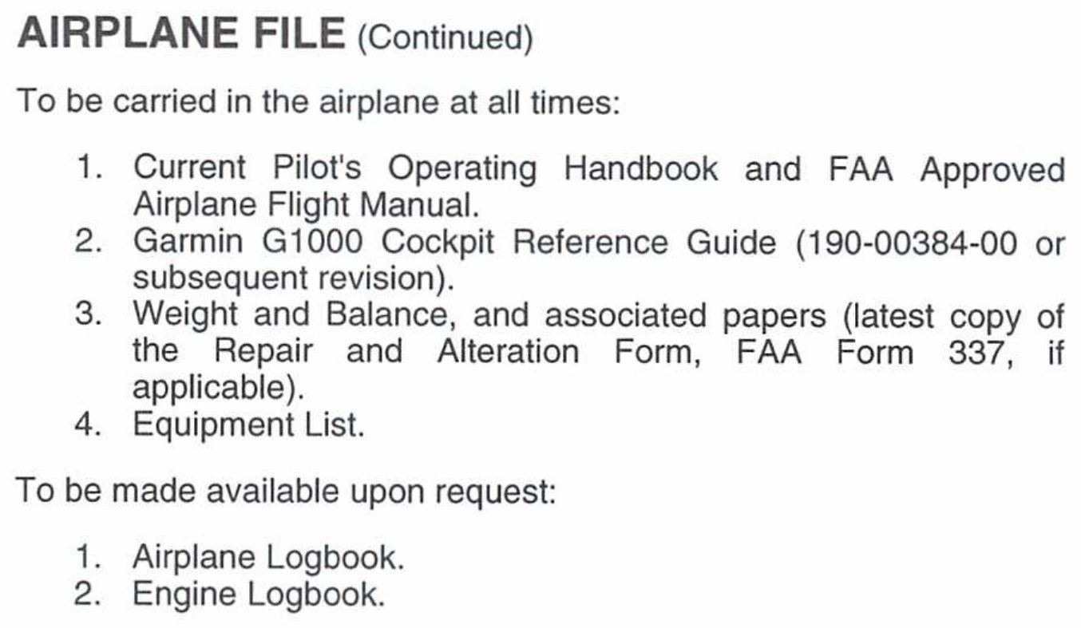
Logbook Documentation
AI.III.B.K1b
Work done, date, signature
Total time, AD status
Kept by owner or operator
Some records stay with plane
Maintenance records must include a description of the work, the date completed, and the signature and certificate number of the person approving return to service (14 CFR 91.417).
Records must also show total time in service, status of life-limited parts, time since overhaul, current inspection status, and current AD status with method of compliance (14 CFR 91.417).
Work records are kept until the work is repeated or superseded, or for 1 year. Total time, AD status, and similar records are kept and transferred with the aircraft when sold (14 CFR 91.417).
C172S POH: the airplane logbook and engine logbook are to be made available on request (POH 8-7).
KNOW THIS FOR THE CHECKRIDE
Every maintenance entry: what was done, the date, and the signature and certificate number.
Source: 14 CFR 91.417, POH 8-7
52
Notes:
Before a flight, the pilot checks that the logs show a current annual, 100-hour if needed, ADs, transponder, and ELT.

Slide 53
Quick Check
AI.III.B.K1b
1
How often is an annual inspection required?
Answer: Within the preceding 12 calendar months (14 CFR 91.409).
3
How often must the transponder be checked?
Answer: Every 24 calendar months (14 CFR 91.413).
2
You give paid instruction in an airplane you provide. What other inspection applies?
Answer: The 100-hour inspection (14 CFR 91.409).
4
What three things must a maintenance entry include?
Answer: Description of work, date, and the signature and certificate number of the person approving return to service (14 CFR 91.417).
Source: 14 CFR 91.409, 91.413, 91.417
53
Notes:
Ask each question and let the student answer before showing the answer. Q1: How often is an annual inspection required? A: Within the preceding 12 calendar months (14 CFR 91.409). Q2: You give paid instruction in an airplane you provide. What other inspection applies? A: The 100-hour inspection (14 CFR 91.409). Q3: How often must the transponder be checked? A: Every 24 calendar months (14 CFR 91.413). Q4: What three things must a maintenance entry include? A: Description of work, date, and the signature and certificate number of the person approving return to service (14 CFR 91.417).

Slide 54
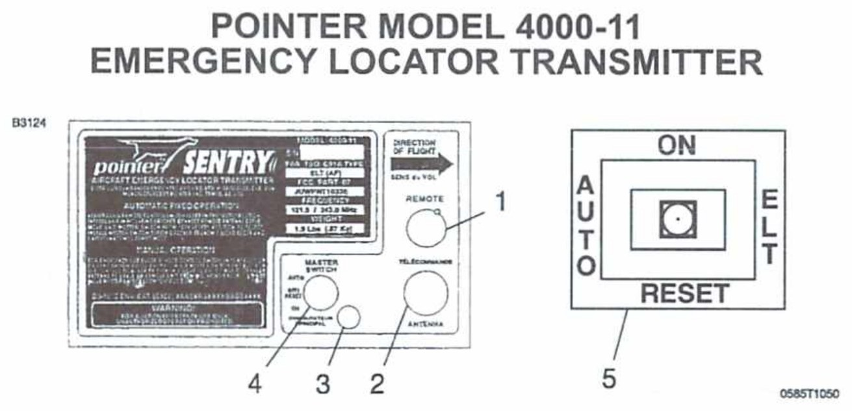
AI.XII.D.K1
Emergency Locator Transmitter
What you will learn
How the ELT works
Using the C172S ELT
Limitations
Testing and inspection rules
Why it matters: the ELT is how search and rescue finds you. Your students should know how to turn it on and when they may test it.
Source: AIM 6-2-4, 14 CFR 91.207, POH Supplement 1
54
Notes:
Section: Emergency Locator Transmitter. Why it matters: the ELT is how search and rescue finds you. Your students should know how to turn it on and when they may test it.

Slide 55
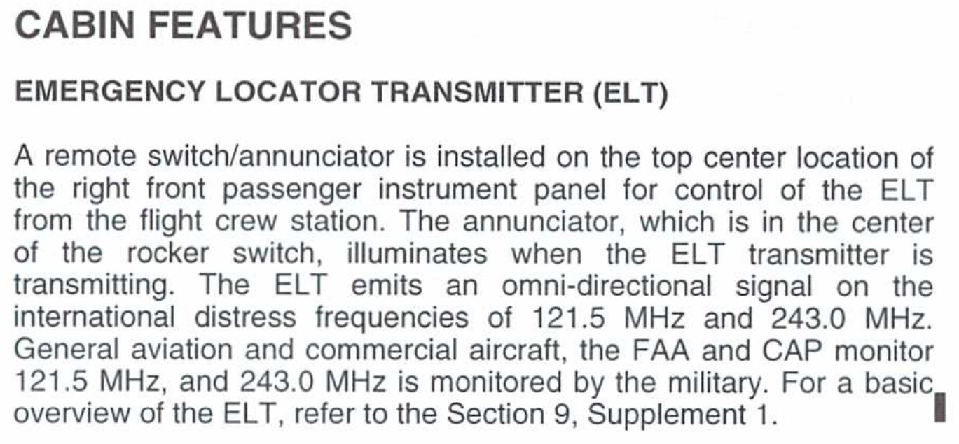
ELT Operations
AI.XII.D.K1
121.5, 243.0, or 406 MHz
G switch auto activates
Transmits at least 48 hours
406 MHz: register with NOAA
ELTs operate on 121.5 MHz, 243.0 MHz, or 406 MHz. The 406 MHz ELT is digital and can carry owner and aircraft data (AIM 6-2-4).
When armed, ELTs activate automatically from crash forces and transmit continuously for at least 48 hours (AIM 6-2-4).
406 MHz ELTs must be registered with NOAA (AIM 6-2-4).
C172S (this POH): Pointer Model 4000-11. AUTO arms the G switch, ON activates it for test or emergency, OFF/RESET deactivates it (POH S1-7).
Source: AIM 6-2-4, POH S1-7
55
Notes:
The C172S ELT in this POH transmits on 121.5 and 243.0. The 406 MHz units are digital and much faster for search and rescue.

Slide 56
Using the C172S ELT
AI.XII.D.K1
Remote switch on panel
Before forced landing: ON
Rescue seen: RESET, AUTO
After rescue: AUTO
The remote switch and annunciator are on the top center of the right front passenger panel. The light comes on when the ELT transmits (POH 7-71).
Before a forced landing, especially in remote or mountain areas, set the remote switch to ON (POH S1-8).
After landing: verify activation and listen on 121.5. Save the battery until you see rescue aircraft. Then set RESET and release to AUTO, and try to call on 121.5. If no contact, go back to ON (POH S1-9).
REAL WORLD SCENARIO
After a forced landing in a field, your student is about to call on the radio with the ELT running. Walk them through the POH steps.
Source: POH 7-71, POH S1-8, POH S1-9
56
Notes:
The remote switch is on the top center of the right side panel. The light shows when it is transmitting.

Slide 57
ELT Limitations
AI.XII.D.K1
Satellites stopped 121.5 in 2009
121.5: needs ATC or aircraft
Must survive the crash
False alarms slow response
Cospas-Sarsat stopped monitoring 121.5 and 243.0 MHz in 2009. Those ELTs depend on ATC or an overflying aircraft hearing the signal (AIM 6-2-4).
SAR forces wait for confirmation on 121.5/243.0 alerts, which can take hours, but can respond to 406 MHz alerts in minutes (AIM 6-2-4).
An ELT helps only if it survives the crash and activates (AIM 6-2-4).
False alarms cause expensive searches and can hide real signals. Monitor 121.5 before engine shutdown at the end of each flight (AIM 6-2-4).
KNOW THIS FOR THE CHECKRIDE
Satellites stopped listening to 121.5 MHz in 2009. A 121.5 ELT depends on someone hearing it (AIM 6-2-4).
Source: AIM 6-2-4
57
Notes:
A 121.5 ELT depends on someone hearing it. That can take hours. That is the biggest limitation.

Slide 58
ELT Testing and Rules
AI.XII.D.K1
Test first 5 minutes of hour
No more than 3 sweeps
Inspect every 12 calendar months
Battery: 1 hour or 50% life
Analog 121.5/243 ELTs: test only during the first 5 minutes after any hour, for no more than three audible sweeps. Digital 406 MHz ELTs: test per the manufacturer. Airborne tests are not authorized (AIM 6-2-4).
C172S POH: test every 100 hours, within the first 5 minutes of the hour, permitting only three emergency tones (POH S1-10).
14 CFR 91.207: inspect within 12 calendar months for installation, battery corrosion, controls and crash sensor, and signal. Replace or recharge the battery after more than 1 cumulative hour of use or at 50 percent of its useful life. Mark the expiration date on the transmitter and in the maintenance record.
Exceptions include training operations conducted entirely within 50 nautical miles of the airport where they began, and an ELT removed for repair for up to 90 days with a logbook entry and an "ELT not installed" placard (14 CFR 91.207).
MEMORY AID
5, 3, 12, 1, 50: first 5 minutes, 3 sweeps, 12 month inspection, 1 hour of use, 50 percent battery life.
Source: AIM 6-2-4, 14 CFR 91.207, POH S1-10
58
Notes:
Analog ELTs: test only in the first 5 minutes after the hour, no more than three sweeps. No airborne tests.

Slide 59
Quick Check
AI.XII.D.K1
1
When may you test an analog ELT?
Answer: In the first 5 minutes after the hour, no more than three sweeps (AIM 6-2-4).
2
When must the ELT battery be replaced?
Answer: After more than 1 cumulative hour of use, or at 50 percent of its useful life (14 CFR 91.207).
3
You are about to make a forced landing in the mountains. What do you do with the ELT?
Answer: Set the remote switch to ON (POH S1-8).
Source: AIM 6-2-4, 14 CFR 91.207, POH S1-8
59
Notes:
Ask each question and let the student answer before showing the answer. Q1: When may you test an analog ELT? A: In the first 5 minutes after the hour, no more than three sweeps (AIM 6-2-4). Q2: When must the ELT battery be replaced? A: After more than 1 cumulative hour of use, or at 50 percent of its useful life (14 CFR 91.207). Q3: You are about to make a forced landing in the mountains. What do you do with the ELT? A: Set the remote switch to ON (POH S1-8).

Slide 60
Study Guide Fixes
AI.II.E.K1c, AI.II.F.K3, AI.II.H.K1, A...
Throttle: fuel-air flow, not fuel
C172S: no propeller control
Fix reverse sensing with OBS
Use PHAK W&B wording
Throttle controls fuel-air flow (PHAK 7-5).
The C172S has a fixed-pitch propeller and no propeller control (POH 7-36).
For reverse sensing, set the OBS so TO/FROM matches your direction of flight (PHAK 16-26).
Use PHAK definitions for weight and balance terms (PHAK 10-4, PHAK 10-5).
Brake horsepower: teach it as engine power. The "measured with a brake" explanation is not in the FAA handbooks (PHAK 5-29).
Source: PHAK 7-5, POH 7-36, PHAK 16-26, PHAK 10-4, PHAK 5-29
60
Notes:
These are the places where my study guide answers differ from the FAA books. On the checkride, use the FAA wording.

Slide 61
Review Questions
Review
Name the perception factors
Positive vs. neutral static?
East variation: add or subtract?
When may you test an ELT?
Source: AIH 3-7, PHAK 5-14, PHAK 16-7, AIM 6-2-4
61
Notes:
Answers: physical organism, goals and values, self-concept, time and opportunity, element of threat. Returns versus stays. Subtract. First 5 minutes after the hour, three sweeps max.

Slide 62
References
Review
AIH, PHAK, AIM
14 CFR Part 91
C172S POH, TCDS 3A12
FAA-S-ACS-25
Source: See lesson plan for full list
62
Notes:
All facts came from these. The C172S pages are from a training copy; use the POH for the airplane you fly.

